Slide 1

Applied Pattern Recognition
Mohammad Nasucha, S.T., M.Sc., Ph.D.
Program Studi Teknik Informatika
Universitas Pembangunan Jaya
Jl. Cendrawasih, Sawah Baru, Bintaro Jaya
Tangerang Selatan

Slide 2
M01 Introduction
What is This Course About?
Scope of This Course
About Python
Preparing Python and Its IDE

Slide 3
What is this course about?
This is a course on pattern recognition. Here “pattern” means the pattern that we can find in various types of data. Examples of data that may contain patterns:
images, whether it is a single image or a streaming (video)
sound, including voice
data of sun ray intensity in a city in a day, a month, or a year
data of rice production in 12 months
data of water consumption in a city in 12 months
data of the amount of transaction (in USD) in Amazon in 12 months,
etc.

Slide 4
M01 Introduction
What is This Course About?
Scope of This Course
About Python
Preparing Python and Its IDE

Slide 5
Scope of This Course
Introduction (this session)
Root Mean Squared Error (RMSE)
Approximating Data Pattern Using Linear Regression
Approximating Data Pattern Using Polynomial Model
Bayes’ Theorem
Classifying A Number of Patterns Using the k-nearest neighbors (KNN) Algorithm
Theory and Concept of Neural Networks
Classifying A Number of Patterns Using Neural Networks

Slide 6
M01 Introduction
What is This Course About?
Scope of This Course
About Python
Preparing Python and Its IDE

Slide 7
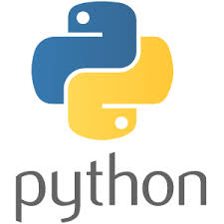
What is Python? (1)
What is Python? [1] 1 point
Python is a popular programming language created by Guido van Rossum, and released in 1991.
What is it usually used for? [1] 4 points
web development (server-side),
software development,
mathematics,
system scripting
What can Python do? [1] 6 points
Python can be used on a server to create web applications.
Python can be used alongside software to create workflows.
Python can connect to database systems. It can also read and modify files.
Python can be used to handle big data and perform complex mathematics.
Python can be used to produce a GUI-featured application.
Python can be used for rapid prototyping, or for production-ready software development.
[1] Python Introduction. https://www.w3schools.com/python/python_intro.asp accesed 22 July 2020.

Slide 8
What is Python? (2)
Reasons of Preference to Python may include [1]: 5 points
Python works on different platforms (Windows, Mac, Linux, Raspberry Pi, etc).
Python syntax is similar to the English language.
Python syntax allows developers to write programs with fewer lines than some others do.
Python runs on an interpreter system, meaning that code can be executed as soon as it is written. This means that prototyping can be quick.
Python facilitates both procedural / functional and object-orientated programming paradigms.
[1] Python Introduction. https://www.w3schools.com/python/python_intro.asp accesed 22 July 2020.

Slide 9
What is Python? (3)
Python Syntax Style: 3 points
Python syntax was designed to be easily understood by human.
Python does not use a semicolon neither parentheses to end a command. Changing the line means completion of a command.
Python does not use curly-brackets for conditions, loops, functions and classes. Python relies on indentation.
Good to Know [1]: 2 points
The latest version of Python is Python 3. However, Python 2 is still quite popular.
You can write Python in a text editor or an Integrated Development Environment, such as PhyCharm, Thonny, Netbeans or Eclipse. IDE are useful when managing many Python files.
[1] Python Introduction. https://www.w3schools.com/python/python_intro.asp accesed 22 July 2020.

Slide 10
M01 Introduction
What is This Course About?
Scope of This Course
About Python
Preparing Python and Its IDE

Slide 11
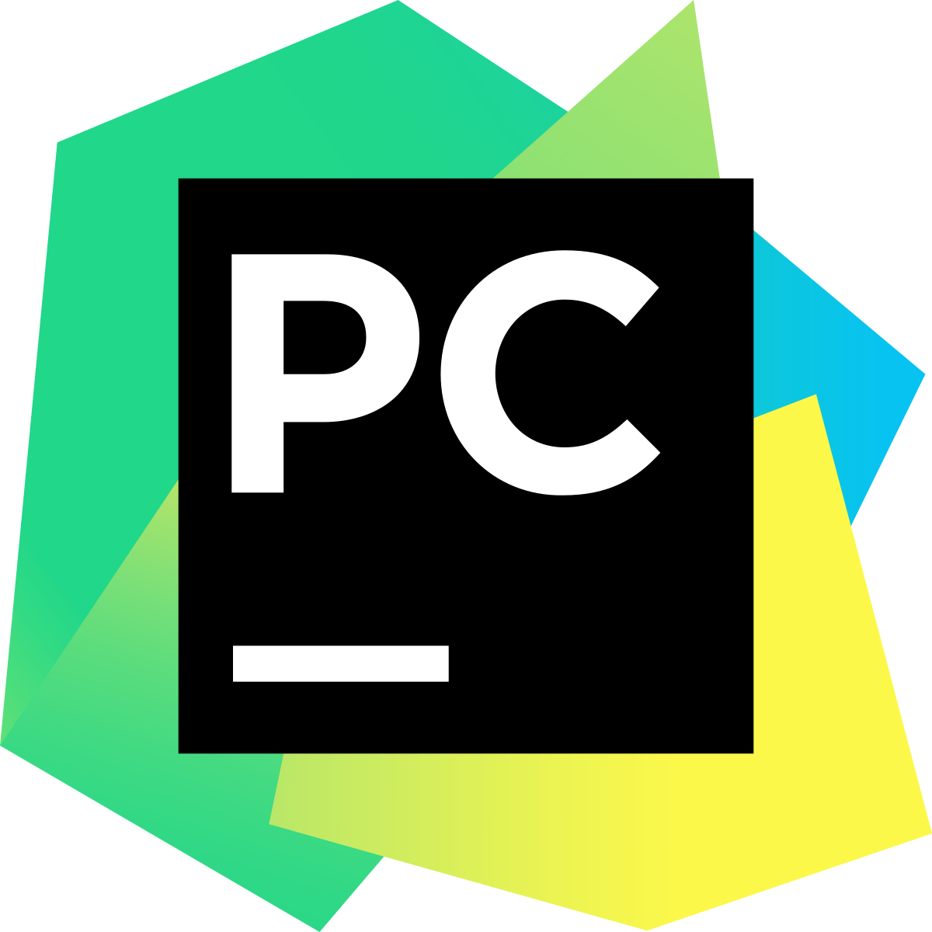
Preparing the Python and Its Development Environment
To prepare the Python and Its Development Environment, follow the instruction discussed in https://www.youtube.com/watch?v=AUiM1UaRCPc&t=36s.
That basically includes the installation of Python and PyCharm.
When installing please choose “Install for All Users”.

Slide 12
M01 Introduction
What is This Course About?
Scope of This Course
About Python
Preparing Python and Its IDE
How to Install Packages / Library

Slide 13
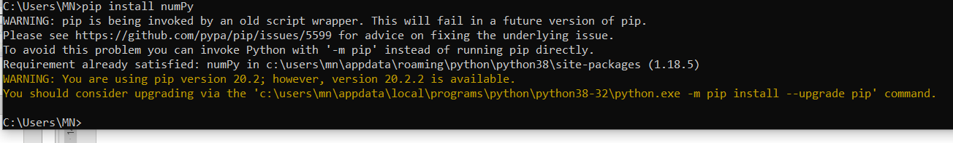
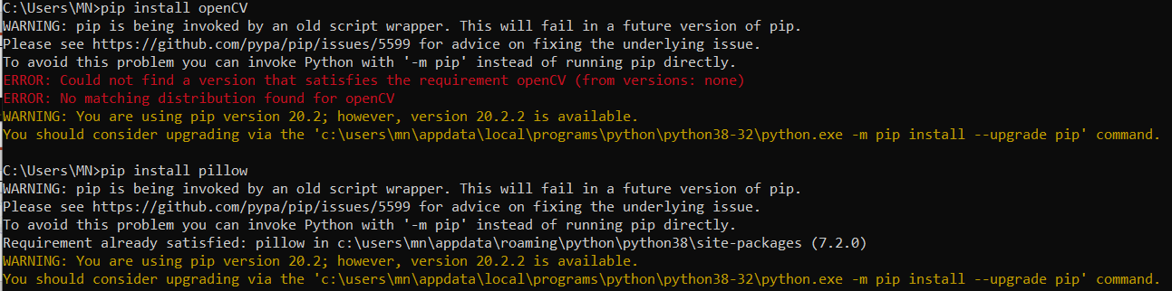
Installing Package(s)
Melalui windows command prompt:
  C:\users\MN\ pip install numPy
  C:\users\MN\ pip install matplotlib

Slide 14
Terima Kasih

